Slide 1
Attacks on DHCP and DNS
CS 514 / ECE 558
Most slides (used with permission) from
CS 161: Computer Security
Prof. Vern Paxson
University of California, Berkeley

Slide 2
Internet Bootstrapping: DHCP
New host doesn’t have an IP address yet
  So, host doesn’t know what source address to use
Host doesn’t know who to ask for an IP address
  So, host doesn’t know what destination address to use
Solution: shout to “discover” server that can help
  Broadcast a server-discovery message (layer 2)
  Server(s) sends a reply offering an address
host
host
...
host
DHCP = Dynamic Host Configuration Protocol
DHCP server

Slide 3


Dynamic Host Configuration Protocol
DHCP discover
(broadcast)
new
client
DHCP offer
DHCP server
“offer” message includes IP address, DNS server, “gateway router”, and how long client can have these (“lease” time)
DNS server = system used by client to map hostnames like gmail.com to IP addresses like 74.125.224.149
Gateway router = router that client uses as the first hop for all of its Internet traffic to remote hosts

Slide 4
Dynamic Host Configuration Protocol
DHCP discover
(broadcast)
new
client
DHCP offer
DHCP server
“offer” message includes IP address, DNS server, “gateway router”, and how long client can have these (“lease” time)
DHCP request
(broadcast)
DHCP ACK

Slide 5
Dynamic Host Configuration Protocol
DHCP discover
(broadcast)
new
client
DHCP offer
DHCP server
“offer” message includes IP address, DNS server, “gateway router”, and how long client can have these (“lease” time)
DHCP request
Local attacker on same subnet can hear new host’s DHCP request
(broadcast)
DHCP ACK

Slide 6
Dynamic Host Configuration Protocol
DHCP discover
(broadcast)
new
client
DHCP offer
DHCP server
“offer” message includes IP address, DNS server, “gateway router”, and how long client can have these (“lease” time)
DHCP request
(broadcast)
DHCP ACK
Attacker can race the actual server; if attacker wins, replaces DNS server and/or gateway router

Slide 7
Dynamic Host Configuration Protocol
DHCP discover
(broadcast)
new
client
DHCP offer
DHCP server
“offer” message includes IP address, DNS server, “gateway router”, and how long client can have these (“lease” time)
DHCP request
(broadcast)
Threats?
DHCP ACK

Slide 8
DHCP Threats
Substitute a fake DNS server
  Redirect any of a host’s lookups to a machine of attacker’s choice (e.g., gmail.com = 6.6.6.6)
Substitute a fake gateway router
  Intercept all of a host’s off-subnet traffic
    (even if not preceded by a DNS lookup)
  Relay contents back and forth between host and remote server
    Modify however attacker chooses
  This is one type of invisible Man In The Middle (MITM)
    Victim host generally has no way of knowing it’s happening! :-(
    (Can’t necessarily alarm on peculiarity of receiving multiple DHCP replies, since that can happen benignly)
How can we fix this?
Hard

Slide 9

DNS Lookups via a Resolver
root DNS server (‘.’)
Host at xyz.poly.edu wants IP address for gaia.cs.umass.edu
2
3
TLD DNS server (‘.edu’)
4
local DNS server
(resolver)
dns.poly.edu
5
Caching heavily used to minimize lookups
6
1
7
8
authoritative DNS server
(‘umass.edu’, ‘cs.umass.edu’)
dns.cs.umass.edu
requesting host
xyz.poly.edu
gaia.cs.umass.edu

Slide 10
DNS Threats
DNS: path-critical for just about everything we do
  Maps hostnames ⇔ IP addresses
  Design only scales if we can minimize lookup traffic
    #1 way to do so: caching
    #2 way to do so: return not only answers to queries, but additional info that will likely be needed shortly
What if attacker eavesdrops on our DNS queries?
  Then similar to DHCP, can redirect us w/ misinformation
Consider attackers who can’t eavesdrop - but still aim to manipulate us via how the protocol functions
Directly interacting w/ DNS: dig program on Unix
  Allows querying of DNS system
  Dumps each field in DNS responses

Slide 11
dig eecs.mit.edu A
; ; <<>> DiG 9.6.0-APPLE-P2 <<>> eecs.mit.edu a
;; global options: +cmd
;; Got answer:
;; ->>HEADER<<- opcode: QUERY, status: NOERROR, id: 19901
;; flags: qr rd ra; QUERY: 1, ANSWER: 1, AUTHORITY: 3, ADDITIONAL: 3
;; QUESTION SECTION:
;eecs.mit.edu. IN A
;; ANSWER SECTION:
eecs.mit.edu. 21600 IN A 18.62.1.6
;; AUTHORITY SECTION:
mit.edu. 11088 IN NS BITSY.mit.edu.
mit.edu. 11088 IN NS W20NS.mit.edu.
mit.edu. 11088 IN NS STRAWB.mit.edu.
;; ADDITIONAL SECTION:
STRAWB.mit.edu. 126738 IN A 18.71.0.151
BITSY.mit.edu. 166408 IN A 18.72.0.3
W20NS.mit.edu. 126738 IN A 18.70.0.160
Use Unix “dig” utility to look up IP address (“A”) for hostname eecs.mit.edu via DNS

Slide 12
dig eecs.mit.edu A
; ; <<>> DiG 9.6.0-APPLE-P2 <<>> eecs.mit.edu a
;; global options: +cmd
;; Got answer:
;; ->>HEADER<<- opcode: QUERY, status: NOERROR, id: 19901
;; flags: qr rd ra; QUERY: 1, ANSWER: 1, AUTHORITY: 3, ADDITIONAL: 3
;; QUESTION SECTION:
;eecs.mit.edu. IN A
;; ANSWER SECTION:
eecs.mit.edu. 21600 IN A 18.62.1.6
;; AUTHORITY SECTION:
mit.edu. 11088 IN NS BITSY.mit.edu.
mit.edu. 11088 IN NS W20NS.mit.edu.
mit.edu. 11088 IN NS STRAWB.mit.edu.
;; ADDITIONAL SECTION:
STRAWB.mit.edu. 126738 IN A 18.71.0.151
BITSY.mit.edu. 166408 IN A 18.72.0.3
W20NS.mit.edu. 126738 IN A 18.70.0.160
This is dig identifying its version and the query it is attempting to look up

Slide 13
dig eecs.mit.edu A
; ; <<>> DiG 9.6.0-APPLE-P2 <<>> eecs.mit.edu a
;; global options: +cmd
;; Got answer:
;; ->>HEADER<<- opcode: QUERY, status: NOERROR, id: 19901
;; flags: qr rd ra; QUERY: 1, ANSWER: 1, AUTHORITY: 3, ADDITIONAL: 3
;; QUESTION SECTION:
;eecs.mit.edu. IN A
;; ANSWER SECTION:
eecs.mit.edu. 21600 IN A 18.62.1.6
;; AUTHORITY SECTION:
mit.edu. 11088 IN NS BITSY.mit.edu.
mit.edu. 11088 IN NS W20NS.mit.edu.
mit.edu. 11088 IN NS STRAWB.mit.edu.
;; ADDITIONAL SECTION:
STRAWB.mit.edu. 126738 IN A 18.71.0.151
BITSY.mit.edu. 166408 IN A 18.72.0.3
W20NS.mit.edu. 126738 IN A 18.70.0.160
Status values returned from the remote name server queried by dig

Slide 14
dig eecs.mit.edu A
; ; <<>> DiG 9.6.0-APPLE-P2 <<>> eecs.mit.edu a
;; global options: +cmd
;; Got answer:
;; ->>HEADER<<- opcode: QUERY, status: NOERROR, id: 19901
;; flags: qr rd ra; QUERY: 1, ANSWER: 1, AUTHORITY: 3, ADDITIONAL: 3
;; QUESTION SECTION:
;eecs.mit.edu. IN A
;; ANSWER SECTION:
eecs.mit.edu. 21600 IN A 18.62.1.6
;; AUTHORITY SECTION:
mit.edu. 11088 IN NS BITSY.mit.edu.
mit.edu. 11088 IN NS W20NS.mit.edu.
mit.edu. 11088 IN NS STRAWB.mit.edu.
;; ADDITIONAL SECTION:
STRAWB.mit.edu. 126738 IN A 18.71.0.151
BITSY.mit.edu. 166408 IN A 18.72.0.3
W20NS.mit.edu. 126738 IN A 18.70.0.160
Including a 16-bit transaction identifier that enables the DNS client (dig, in this case) to match up the reply with its original request

Slide 15
dig eecs.mit.edu A
; ; <<>> DiG 9.6.0-APPLE-P2 <<>> eecs.mit.edu a
;; global options: +cmd
;; Got answer:
;; ->>HEADER<<- opcode: QUERY, status: NOERROR, id: 19901
;; flags: qr rd ra; QUERY: 1, ANSWER: 1, AUTHORITY: 3, ADDITIONAL: 3
;; QUESTION SECTION:
;eecs.mit.edu. IN A
;; ANSWER SECTION:
eecs.mit.edu. 21600 IN A 18.62.1.6
;; AUTHORITY SECTION:
mit.edu. 11088 IN NS BITSY.mit.edu.
mit.edu. 11088 IN NS W20NS.mit.edu.
mit.edu. 11088 IN NS STRAWB.mit.edu.
;; ADDITIONAL SECTION:
STRAWB.mit.edu. 126738 IN A 18.71.0.151
BITSY.mit.edu. 166408 IN A 18.72.0.3
W20NS.mit.edu. 126738 IN A 18.70.0.160
The name server echoes back the question that it is answering as the first part of its reply

Slide 16
dig eecs.mit.edu A
; ; <<>> DiG 9.6.0-APPLE-P2 <<>> eecs.mit.edu a
;; global options: +cmd
;; Got answer:
;; ->>HEADER<<- opcode: QUERY, status: NOERROR, id: 19901
;; flags: qr rd ra; QUERY: 1, ANSWER: 1, AUTHORITY: 3, ADDITIONAL: 3
;; QUESTION SECTION:
;eecs.mit.edu. IN A
;; ANSWER SECTION:
eecs.mit.edu. 21600 IN A 18.62.1.6
;; AUTHORITY SECTION:
mit.edu. 11088 IN NS BITSY.mit.edu.
mit.edu. 11088 IN NS W20NS.mit.edu.
mit.edu. 11088 IN NS STRAWB.mit.edu.
;; ADDITIONAL SECTION:
STRAWB.mit.edu. 126738 IN A 18.71.0.151
BITSY.mit.edu. 166408 IN A 18.72.0.3
W20NS.mit.edu. 126738 IN A 18.70.0.160
“Answer” tells us the IP address associated with eecs.mit.edu is 18.62.1.6 and we can cache the result for 21,600 seconds

Slide 17
dig eecs.mit.edu A
; ; <<>> DiG 9.6.0-APPLE-P2 <<>> eecs.mit.edu a
;; global options: +cmd
;; Got answer:
;; ->>HEADER<<- opcode: QUERY, status: NOERROR, id: 19901
;; flags: qr rd ra; QUERY: 1, ANSWER: 1, AUTHORITY: 3, ADDITIONAL: 3
;; QUESTION SECTION:
;eecs.mit.edu. IN A
;; ANSWER SECTION:
eecs.mit.edu. 21600 IN A 18.62.1.6
;; AUTHORITY SECTION:
mit.edu. 11088 IN NS BITSY.mit.edu.
mit.edu. 11088 IN NS W20NS.mit.edu.
mit.edu. 11088 IN NS STRAWB.mit.edu.
;; ADDITIONAL SECTION:
STRAWB.mit.edu. 126738 IN A 18.71.0.151
BITSY.mit.edu. 166408 IN A 18.72.0.3
W20NS.mit.edu. 126738 IN A 18.70.0.160
In general, a single Resource Record (RR) like this includes, left-to-right, a DNS name, a time-to-live, a family (IN for our purposes - ignore), a type (A here), and an associated value

Slide 18
dig eecs.mit.edu A
; ; <<>> DiG 9.6.0-APPLE-P2 <<>> eecs.mit.edu a
;; global options: +cmd
;; Got answer:
;; ->>HEADER<<- opcode: QUERY, status: NOERROR, id: 19901
;; flags: qr rd ra; QUERY: 1, ANSWER: 1, AUTHORITY: 3, ADDITIONAL: 3
;; QUESTION SECTION:
;eecs.mit.edu. IN A
;; ANSWER SECTION:
eecs.mit.edu. 21600 IN A 18.62.1.6
;; AUTHORITY SECTION:
mit.edu. 11088 IN NS BITSY.mit.edu.
mit.edu. 11088 IN NS W20NS.mit.edu.
mit.edu. 11088 IN NS STRAWB.mit.edu.
;; ADDITIONAL SECTION:
STRAWB.mit.edu. 126738 IN A 18.71.0.151
BITSY.mit.edu. 166408 IN A 18.72.0.3
W20NS.mit.edu. 126738 IN A 18.70.0.160
“Authority” tells us the name servers responsible for the answer. Each RR gives the hostname of a different name server (“NS”) for names in mit.edu. We should cache each record for 11,088 seconds.
If the “Answer” had been empty, then the resolver’s next step would be to send the original query to one of these name servers.

Slide 19
dig eecs.mit.edu A
; ; <<>> DiG 9.6.0-APPLE-P2 <<>> eecs.mit.edu a
;; global options: +cmd
;; Got answer:
;; ->>HEADER<<- opcode: QUERY, status: NOERROR, id: 19901
;; flags: qr rd ra; QUERY: 1, ANSWER: 1, AUTHORITY: 3, ADDITIONAL: 3
;; QUESTION SECTION:
;eecs.mit.edu. IN A
;; ANSWER SECTION:
eecs.mit.edu. 21600 IN A 18.62.1.6
;; AUTHORITY SECTION:
mit.edu. 11088 IN NS BITSY.mit.edu.
mit.edu. 11088 IN NS W20NS.mit.edu.
mit.edu. 11088 IN NS STRAWB.mit.edu.
;; ADDITIONAL SECTION:
STRAWB.mit.edu. 126738 IN A 18.71.0.151
BITSY.mit.edu. 166408 IN A 18.72.0.3
W20NS.mit.edu. 126738 IN A 18.70.0.160
“Additional” provides extra information to save us from making separate lookups for it, or helps with bootstrapping.
Here, it tells us the IP addresses for the hostnames of the name servers. We add these to our cache.

Slide 20
DNS Protocol
IP Header
Lightweight exchange of query and reply messages, both with same message format
Primarily uses UDP for its transport protocol, which is what we’ll assume
Frequently, both clients and servers use port 53
16 bits
16 bits
SRC port
DST port
UDP Header
checksum
length
DNS
Query
or
Reply
Identification
Flags
# Questions
# Answer RRs
# Authority RRs
# Additional RRs
Questions
(variable # of resource records)
UDP Payload
Answers
(variable # of resource records)
Authority
(variable # of resource records)
Additional information
(variable # of resource records)

Slide 21
DNS Protocol
IP Header
Lightweight exchange of query and reply messages, both with same message format
Primarily uses UDP for its transport protocol, which is what we’ll assume
Frequently, both clients and servers use port 53
16 bits
16 bits
SRC=53
DST=53
UDP Header
checksum
length
DNS
Query
or
Reply
Identification
Flags
# Questions
# Answer RRs
# Authority RRs
# Additional RRs
Questions
(variable # of resource records)
UDP Payload
Answers
(variable # of resource records)
Authority
(variable # of resource records)
Additional information
(variable # of resource records)

Slide 22
DNS Protocol, con’t
IP Header
Message header:
Identification: 16 bit # for query, reply to query uses same #
Along with repeating the Question and providing Answer(s), replies can include “Authority” (name server responsible for answer) and “Additional” (info client is likely to look up soon anyway)
Each Resource Record has a Time To Live (in seconds) for caching (not shown)
16 bits
16 bits
SRC=53
DST=53
checksum
length
Identification
Flags
# Questions
# Answer RRs
# Authority RRs
# Additional RRs
Questions
(variable # of resource records)
Answers
(variable # of resource records)
Authority
(variable # of resource records)
Additional information
(variable # of resource records)

Slide 23
dig eecs.mit.edu A
; ; <<>> DiG 9.6.0-APPLE-P2 <<>> eecs.mit.edu a
;; global options: +cmd
;; Got answer:
;; ->>HEADER<<- opcode: QUERY, status: NOERROR, id: 19901
;; flags: qr rd ra; QUERY: 1, ANSWER: 1, AUTHORITY: 3, ADDITIONAL: 3
;; QUESTION SECTION:
;eecs.mit.edu. IN A
;; ANSWER SECTION:
eecs.mit.edu. 21600 IN A 18.62.1.6
;; AUTHORITY SECTION:
mit.edu. 11088 IN NS BITSY.mit.edu.
mit.edu. 11088 IN NS W20NS.mit.edu.
mit.edu. 11088 IN NS STRAWB.mit.edu.
;; ADDITIONAL SECTION:
STRAWB.mit.edu. 126738 IN A 18.71.0.151
BITSY.mit.edu. 166408 IN A 18.72.0.3
W20NS.mit.edu. 126738 IN A 18.70.0.160
What if the mit.edu server is untrustworthy? Could its operator steal, say, all of our web surfing to berkeley.edu’s main server?

Slide 24
dig eecs.mit.edu A
; ; <<>> DiG 9.6.0-APPLE-P2 <<>> eecs.mit.edu a
;; global options: +cmd
;; Got answer:
;; ->>HEADER<<- opcode: QUERY, status: NOERROR, id: 19901
;; flags: qr rd ra; QUERY: 1, ANSWER: 1, AUTHORITY: 3, ADDITIONAL: 3
;; QUESTION SECTION:
;eecs.mit.edu. IN A
;; ANSWER SECTION:
eecs.mit.edu. 21600 IN A 18.62.1.6
;; AUTHORITY SECTION:
mit.edu. 11088 IN NS BITSY.mit.edu.
mit.edu. 11088 IN NS W20NS.mit.edu.
mit.edu. 11088 IN NS STRAWB.mit.edu.
;; ADDITIONAL SECTION:
STRAWB.mit.edu. 126738 IN A 18.71.0.151
BITSY.mit.edu. 166408 IN A 18.72.0.3
W20NS.mit.edu. 126738 IN A 18.70.0.160
Let’s look at a flaw in the original DNS design (since fixed)

Slide 25
dig eecs.mit.edu A
; ; <<>> DiG 9.6.0-APPLE-P2 <<>> eecs.mit.edu a
;; global options: +cmd
;; Got answer:
;; ->>HEADER<<- opcode: QUERY, status: NOERROR, id: 19901
;; flags: qr rd ra; QUERY: 1, ANSWER: 1, AUTHORITY: 3, ADDITIONAL: 3
;; QUESTION SECTION:
;eecs.mit.edu. IN A
;; ANSWER SECTION:
eecs.mit.edu. 21600 IN A 18.62.1.6
;; AUTHORITY SECTION:
mit.edu. 11088 IN NS BITSY.mit.edu.
mit.edu. 11088 IN NS W20NS.mit.edu.
mit.edu. 30 IN NS www.berkeley.edu.
;; ADDITIONAL SECTION:
www.berkeley.edu. 30 IN A 18.6.6.6
BITSY.mit.edu. 166408 IN A 18.72.0.3
W20NS.mit.edu. 126738 IN A 18.70.0.160
What could happen if the mit.edu server returns the following to us instead?

Slide 26
dig eecs.mit.edu A
; ; <<>> DiG 9.6.0-APPLE-P2 <<>> eecs.mit.edu a
;; global options: +cmd
;; Got answer:
;; ->>HEADER<<- opcode: QUERY, status: NOERROR, id: 19901
;; flags: qr rd ra; QUERY: 1, ANSWER: 1, AUTHORITY: 3, ADDITIONAL: 3
;; QUESTION SECTION:
;eecs.mit.edu. IN A
;; ANSWER SECTION:
eecs.mit.edu. 21600 IN A 18.62.1.6
;; AUTHORITY SECTION:
mit.edu. 11088 IN NS BITSY.mit.edu.
mit.edu. 11088 IN NS W20NS.mit.edu.
mit.edu. 30 IN NS www.berkeley.edu.
;; ADDITIONAL SECTION:
www.berkeley.edu. 30 IN A 18.6.6.6
BITSY.mit.edu. 166408 IN A 18.72.0.3
W20NS.mit.edu. 126738 IN A 18.70.0.160
We’d dutifully store in our cache a mapping of www.berkeley.edu to an IP address under MIT’s control. (It could have been any IP address they wanted, not just one of theirs.)

Slide 27
dig eecs.mit.edu A
; ; <<>> DiG 9.6.0-APPLE-P2 <<>> eecs.mit.edu a
;; global options: +cmd
;; Got answer:
;; ->>HEADER<<- opcode: QUERY, status: NOERROR, id: 19901
;; flags: qr rd ra; QUERY: 1, ANSWER: 1, AUTHORITY: 3, ADDITIONAL: 3
;; QUESTION SECTION:
;eecs.mit.edu. IN A
;; ANSWER SECTION:
eecs.mit.edu. 21600 IN A 18.62.1.6
;; AUTHORITY SECTION:
mit.edu. 11088 IN NS BITSY.mit.edu.
mit.edu. 11088 IN NS W20NS.mit.edu.
mit.edu. 30 IN NS www.berkeley.edu.
;; ADDITIONAL SECTION:
www.berkeley.edu. 30 IN A 18.6.6.6
BITSY.mit.edu. 166408 IN A 18.72.0.3
W20NS.mit.edu. 126738 IN A 18.70.0.160
In this case they chose to make the mapping disappear after 30 seconds. They could have made it persist for weeks, or disappear even quicker.

Slide 28
dig eecs.mit.edu A
; ; <<>> DiG 9.6.0-APPLE-P2 <<>> eecs.mit.edu a
;; global options: +cmd
;; Got answer:
;; ->>HEADER<<- opcode: QUERY, status: NOERROR, id: 19901
;; flags: qr rd ra; QUERY: 1, ANSWER: 1, AUTHORITY: 3, ADDITIONAL: 3
;; QUESTION SECTION:
;eecs.mit.edu. IN A
;; ANSWER SECTION:
eecs.mit.edu. 21600 IN A 18.62.1.6
;; AUTHORITY SECTION:
mit.edu. 11088 IN NS BITSY.mit.edu.
mit.edu. 11088 IN NS W20NS.mit.edu.
mit.edu. 30 IN NS www.berkeley.edu.
;; ADDITIONAL SECTION:
www.berkeley.edu. 30 IN A 18.6.6.6
BITSY.mit.edu. 166408 IN A 18.72.0.3
W20NS.mit.edu. 126738 IN A 18.70.0.160
How do we fix such cache poisoning?

Slide 29
dig eecs.mit.edu A
; ; <<>> DiG 9.6.0-APPLE-P2 <<>> eecs.mit.edu a
;; global options: +cmd
;; Got answer:
;; ->>HEADER<<- opcode: QUERY, status: NOERROR, id: 19901
;; flags: qr rd ra; QUERY: 1, ANSWER: 1, AUTHORITY: 3, ADDITIONAL: 3
;; QUESTION SECTION:
;eecs.mit.edu. IN A
;; ANSWER SECTION:
eecs.mit.edu. 21600 IN A 18.62.1.6
;; AUTHORITY SECTION:
mit.edu. 11088 IN NS BITSY.mit.edu.
mit.edu. 11088 IN NS W20NS.mit.edu.
mit.edu. 30 IN NS www.berkeley.edu.
;; ADDITIONAL SECTION:
www.berkeley.edu. 30 IN A 18.6.6.6
BITSY.mit.edu. 166408 IN A 18.72.0.3
W20NS.mit.edu. 126738 IN A 18.70.0.160
Don’t accept Additional records unless they’re for the domain we’re looking up
  E.g., looking up eecs.mit.edu ⇒ only accept additional records from *.mit.edu
No extra risk in accepting these since server could return them to us directly in an Answer anyway.
=

Slide 30
DNS Threats, con’t
16 bits
16 bits
SRC=53
DST=53
What about blind spoofing?
checksum
length
Say we look up mail.google.com; how can an off-path attacker feed us a bogus A answer before the legitimate server replies?
How can such a remote attacker even know we are looking up mail.google.com?
Identification
Flags
# Questions
# Answer RRs
# Authority RRs
# Additional RRs
Questions
(variable # of resource records)
Answers
(variable # of resource records)
Authority
(variable # of resource records)
Additional information
(variable # of resource records)
Suppose, e.g., we visit a web page under their control:
...<img src="http://mail.google.com" …> ...

Slide 31
DNS Threats, con’t
16 bits
16 bits
SRC=53
DST=53
What about blind spoofing?
checksum
length
Say we look up mail.google.com; how can an off-path attacker feed us a bogus A answer before the legitimate server replies?
How can such an attacker even know we are looking up mail.google.com?
Suppose, e.g., we visit a web page under their control:
Identification
Flags
# Questions
# Answer RRs
# Authority RRs
# Additional RRs
This HTML snippet causes our browser to try to fetch an image from mail.google.com. To do that, our browser first has to look up the IP address associated with that name.
Questions
(variable # of resource records)
Answers
(variable # of resource records)
Authority
(variable # of resource records)
Additional information
(variable # of resource records)
...<img src="http://mail.google.com" …> ...

Slide 32
DNS Blind Spoofing, con’t
Fix?
16 bits
16 bits
Once they know we’re looking it up, they just have to guess the Identification field and reply before legit server.
How hard is that?
SRC=53
DST=53
checksum
length
Identification
Flags
# Questions
# Answer RRs
# Authority RRs
# Additional RRs
Questions
(variable # of resource records)
Originally, identification field incremented by 1 for each request. How does attacker guess it?
Answers
(variable # of resource records)
Authority
(variable # of resource records)
Additional information
(variable # of resource records)
<img src="http://badguy.com" …>
<img src="http://mail.google.com" …>
They observe ID k here
So this will be k+1

Slide 33
DNS Blind Spoofing, con’t
16 bits
16 bits
SRC=53
DST=53
checksum
length
Once we randomize the Identification, attacker has a 1/65536 chance of guessing it correctly.
Are we pretty much safe?
Identification
Flags
# Questions
# Answer RRs
# Authority RRs
# Additional RRs
Questions
(variable # of resource records)
Answers
(variable # of resource records)
Attacker can send lots of replies, not just one …
However: once reply from legit server arrives (with correct Identification), it’s cached and no more opportunity to poison it. Victim is innoculated!
Authority
(variable # of resource records)
Additional information
(variable # of resource records)
Unless attacker can send 1000s of replies before legit arrives, we’re likely safe - phew!
?

Slide 34
DNS Blind Spoofing (Kaminsky 2008)
Two key ideas:
  Spoof uses Additional field (rather than Answer)
  Attacker can get around caching of legit replies by generating a series of different name lookups:
<img src="http://random1.google.com" …>
<img src="http://random2.google.com" …>
<img src="http://random3.google.com" …>
...
<img src="http://randomN.google.com" …>

Slide 35
Kaminsky Blind Spoofing, con’t
;; QUESTION SECTION:
;randomk.google.com. IN A
;; ANSWER SECTION:
randomk.google.com 21600 IN A doesn’t matter
;; AUTHORITY SECTION:
google.com. 11088 IN NS mail.google.com
;; ADDITIONAL SECTION:
mail.google.com 126738 IN A 6.6.6.6
For each lookup of randomk.google.com, attacker spoofs a bunch of records like this, each with a different Identifier
Once they win the race, not only have they poisoned mail.google.com … but also the cached NS record for google.com’s name server - so any future X.google.com lookups go through the attacker’s machine

Slide 36
Kaminsky Blind Spoofing, con’t
;; QUESTION SECTION:
;randomk.google.com. IN A
;; ANSWER SECTION:
randomk.google.com 21600 IN A doesn’t matter
;; AUTHORITY SECTION:
google.com. 11088 IN NS mail.google.com
;; ADDITIONAL SECTION:
mail.google.com 126738 IN A 6.6.6.6
For each lookup of randomk.google.com, attacker spoofs a bunch of records like this, each with a different Identifier
Once they win the race, not only have they poisoned mail.google.com … but also the cached NS record for google.com’s name server - so any future X.google.com lookups go through the attacker’s machine

Slide 37
Advantage Gained by Series of Lookups
Suppose the attacker can deliver 50 spoofed replies before the legitimate authoritative name server replies.
With only one lookup, attacker has a 50/65536 chance of poisoning the cache, which is less than 0.1%.
With a series of 1000 queries, the attacker’s chance of success rises to 1-(65486/65536)¹⁰⁰⁰, which is about 53%.

Slide 38
Defending Against Blind Spoofing
Central problem: all that tells a client they should accept a response is that it matches the Identification field.
With only 16 bits, it lacks sufficient entropy: even if truly random, the search space an attacker must brute force is too small.
Where can we get more entropy? (Without requiring a protocol change.)
16 bits
16 bits
SRC=53
DST=53
checksum
length
Identification
Flags
# Questions
# Answer RRs
# Authority RRs
# Additional RRs
Questions
(variable # of resource records)
Answers
(variable # of resource records)
Authority
(variable # of resource records)
Additional information
(variable # of resource records)

Slide 39
Defending Against Blind Spoofing
Total entropy: 16 bits
For requestor to receive DNS reply, needs both correct Identification and correct ports.
On a request, DST port = 53.
SRC port usually also 53 - but not fundamental, just convenient.
16 bits
16 bits
SRC=53
DST=53
checksum
length
Identification
Flags
# Questions
# Answer RRs
# Authority RRs
# Additional RRs
Questions
(variable # of resource records)
Answers
(variable # of resource records)
Authority
(variable # of resource records)
Additional information
(variable # of resource records)

Slide 40
Defending Against Blind Spoofing
Total entropy: ? bits
“Fix”: client uses random source port ⇒ attacker doesn’t know correct dest. port to use in reply
16 bits
16 bits
SRC=53
DST=rnd
checksum
length
Identification
Flags
# Questions
# Answer RRs
# Authority RRs
# Additional RRs
Questions
(variable # of resource records)
Answers
(variable # of resource records)
Authority
(variable # of resource records)
Additional information
(variable # of resource records)

Slide 41
Defending Against Blind Spoofing
Total entropy: 32 bits
“Fix”: client uses random source port ⇒ attacker doesn’t know correct dest. port to use in reply
32 bits of entropy makes it orders of magnitude harder for attacker to guess all the necessary fields and dupe victim into accepting spoof response.
This is what primarily “secures” DNS against blind spoofing today. (Note: not all resolvers have implemented random source ports!)
16 bits
16 bits
SRC=53
DST=rnd
checksum
length
Identification
Flags
# Questions
# Answer RRs
# Authority RRs
# Additional RRs
Questions
(variable # of resource records)
Answers
(variable # of resource records)
Authority
(variable # of resource records)
Additional information
(variable # of resource records)

Slide 42
Summary of DNS Security Issues
DNS threats highlight:
  Attackers can attack opportunistically rather than eavesdropping
    Cache poisoning only required victim to look up some name under attacker’s control (has been fixed)
  Attackers can often manipulate victims into vulnerable activity
    E.g., IMG SRC in web page to force DNS lookups
  Crucial for identifiers associated with communication to have sufficient entropy (= a lot of bits of unpredictability)
  “Attacks only get better”: threats that appear technically remote can become practical due to unforeseen cleverness

Slide 43
DNS over HTTPS (DoH)
Encrypt DNS queries for privacy and to prevent spoofing
Potentially more round-trips to resolve one name
Cloudflare /Mozilla (Firefox) partnership:
  https://support.mozilla.org/en-US/kb/firefox-dns-over-https
1.1.1.1 Cloudflare IP anycast address
Potentially remote resolver
Potentially interferes with parental controls
Potentially interferes with DNS-based redirection

Slide 44




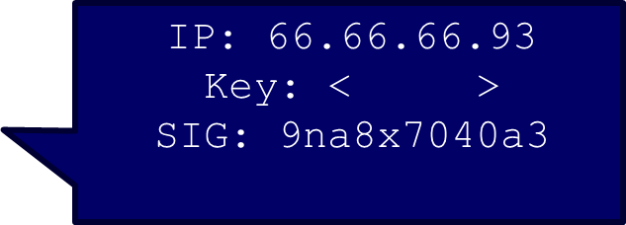
DNSSEC Hierarchy of Trust
Root Zone (ICANN)
.com (Verisign)
IP: 123.45.67.89
Key: < >
SIG: x9fnskflkalk
Where is bankofamerica.com?
dns.bofa.com
dns.evil.com

Slide 45
Some Additional DNS Records
RRSIG – signature for a record set, to be verified with a public key stored in a DNSKEY record
DNSKEY - public key used to verify signatures in RRSIG records
- key signing key (KSK)
- zone signing key (ZSK)
DS (Delegation Signer) – contains the hash of a DNSKEY record, e.g., DS record for example.com in .com domain, hash of example.com zone’s public key

Slide 46
DNSSEC PKI
Prevent DNS cache poisoning attacks by signing all records using public-key cryptography.
PKI is disjoint from SSL/TLS PKI
Employed at the root January 15, 2010. Only one root!
ICANN/IANA signs root records, e.g., delegating .com to Verisign.
Employed for .com, .edu, .net, .gov, .mil top-level domains.
Verisign signs .com records.
Checking is still rare, especially at clients

Slide 47
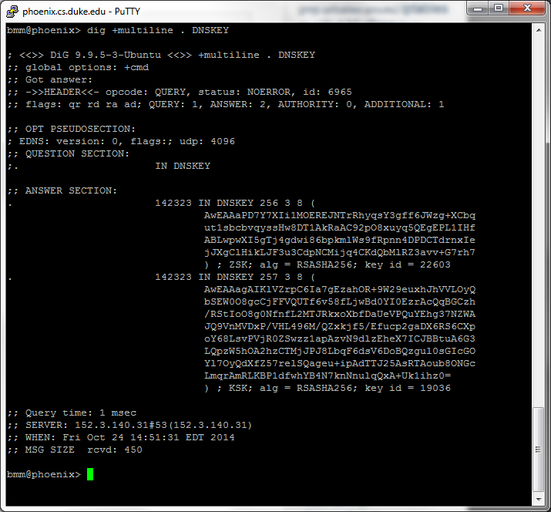
Root Keys
ZSK changes periodically, KSK changes rarely
dig is not a secure method for fetching new root keys

Slide 48

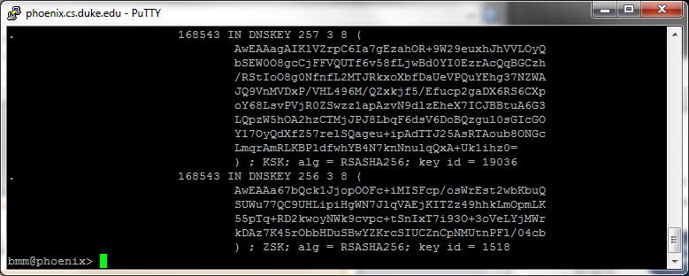
Save Root Keys in Local File
257 is KSK for .
256 is ZSK for .

Slide 49
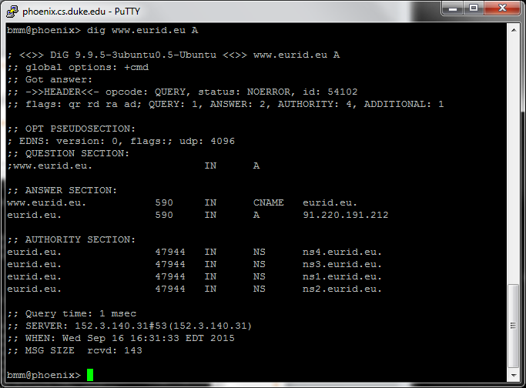
Let’s look up www.eurid.eu
eurid.eu is the canonical name (CNAME) of www.eurid.eu
91.220.191.212 is the IP address for eurid.eu

Slide 50
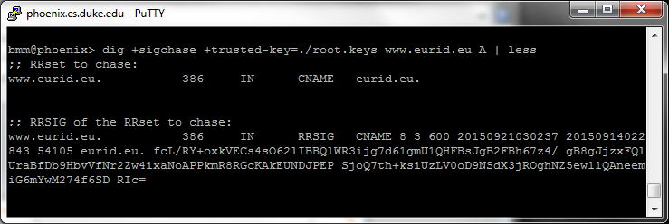
Now chase the key chain for domain www.eurid.edu
Output of dig shown on the following screens
First verify the CNAME resource record
is properly signed by eurid.eu, as shown

Slide 51
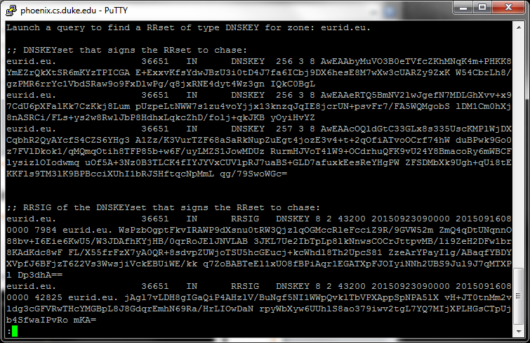
Get public keys for eurid.edu
(1) public keys for eurid.eu; 256 is ZSK, 257 KSK
(2) signatures of ZSKs (signed with KSK)

Slide 52
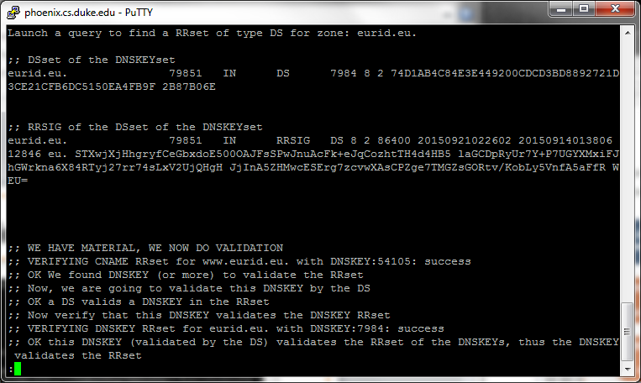
Verify CNAME record for www.eurid.eu
DS record for eurid.eu signed by .eu (don’t verify yet)
Verify (1) CNAME record, signed with eurid.eu ZSK
(2) eurid.eu ZSK, signed with eurid.eu KSK
(3) hash of eurid.eu KSK matches eurid.eu DS record

Slide 53
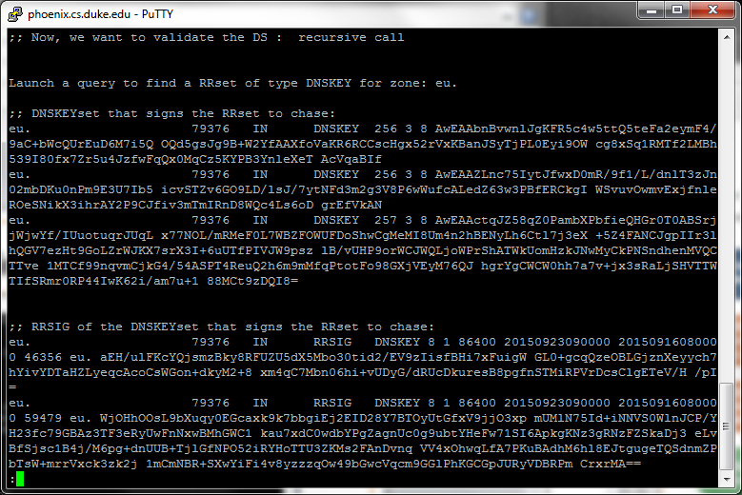
Retrieve ZSKs and KSK for .eu
ZSKs signed using KSK

Slide 54
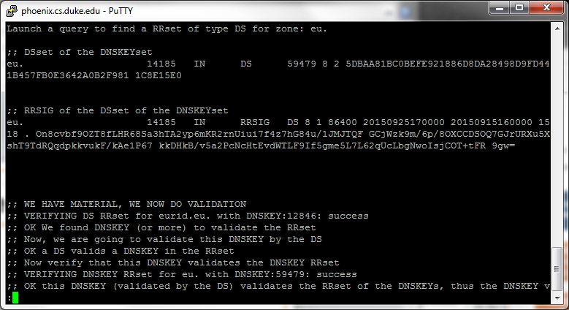
Verify DS record for eurid.eu
DS record for .eu is signed by . (don’t verify yet)
Verify (1) DS record for eurid.eu, signed with .eu ZSK
(2) .eu ZSK, signed with .eu KSK
(3) hash of .eu KSK matches DS record for .eu

Slide 55
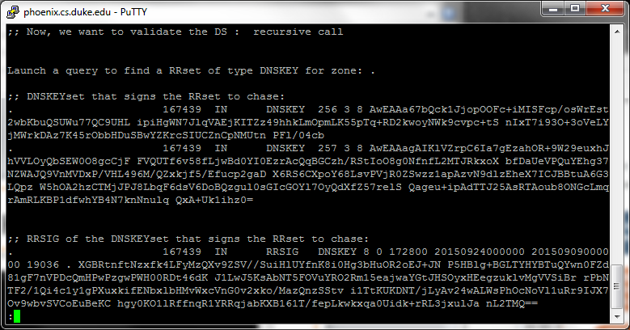
Retrieve ZSK and KSK for .
These keys are the same as the keys that we previously stored in the file./root.keys, which is good! The ZSK is signed with the KSK.

Slide 56
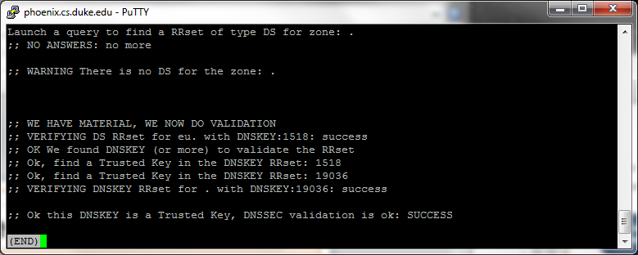
Verify DS record for eu
We don’t find a DS record for . -- but that’s no surprise – who would sign such a thing?
Verify (1) DS record for eu signed with . ZSK
(2) . ZSK is stored in our file ./root.keys
(3) . KSK is stored in our file ./root.keys

